Slide 1
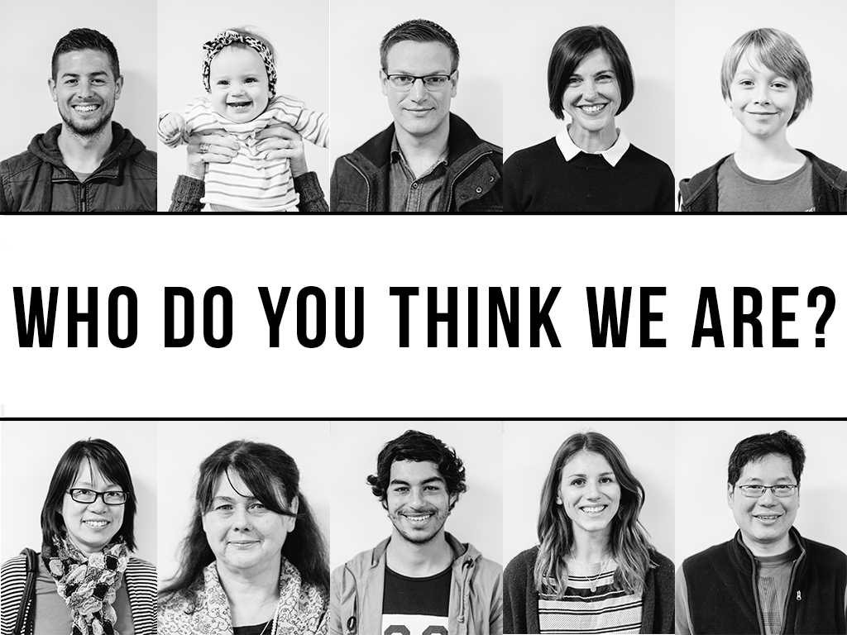

Slide 2
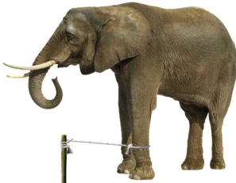
Ephesians 2:11-22

Slide 3
Ephesians 2:11
Therefore, remember that formerly you who are Gentiles by birth and called “uncircumcised” by those who call themselves “the circumcision” (which is done in the body by human hands)—

Slide 4
Ephesians 2:12
remember that at that time you were separate from Christ, excluded from citizenship in Israel and foreigners to the covenants of the promise, without hope and without God in the world.

Slide 5
Ephesians 2:13
But now in Christ Jesus you who once were far away have been brought near by the blood of Christ.

Slide 6
Matthew 26:28
This is my blood of the covenant, which is poured out for many for the forgiveness of sins.

Slide 7
Ephesians 2:14
For he himself is our peace, who has made the two groups one and has destroyed the barrier, the dividing wall of hostility, 15 by setting aside in his flesh the law with its commands and regulations. His purpose was to create in himself one new humanity out of the two, thus making peace,

Slide 8
Ephesians 2:16
and in one body to reconcile both of them to God through the cross, by which he put to death their hostility. 17 He came and preached peace to you who were far away and peace to those who were near. 18 For through him we both have access to the Father by one Spirit.

Slide 10
Ephesians 2:19
19 Consequently, you are no longer foreigners and strangers, but fellow citizens with God’s people and also members of his household, 20 built on the foundation of the apostles and prophets, with Christ Jesus himself as the chief cornerstone.

Slide 11
Ephesians 2:19
21 In him the whole building is joined together and rises to become a holy temple in the Lord. 22 And in him you too are being built together to become a dwelling in which God lives by his Spirit.

Slide 12
We are…
Fellow Citizens in the Kingdom of God
Members of God’s Worldwide Family
Part of God’s ever expanding “MOBILE TEMPLE”
THIS IS WHO WE ARE!

